Slide 1


Data insights
Carlos Diaz
Data Analyst

Slide 2





Introducing myself
Currently holding 4 degrees (2 associates, 2 Bachelors). Pursuing M.B.A in Business intelligence. (Capstone project).
Speak 4 languages.
Started in Data analytics back in 2015 as a career change from Professional Sales with Ingersoll Rand – Trane.
Last position with Publix Credit Union was a 6 months contract.
My next project is to pursue a PHD in A.I in 2022.
My hobbies: Read, coding, play acoustic guitar (Jazz).
1
2
3
4
5
6
Carlos Diaz
Data Analyst

Slide 3
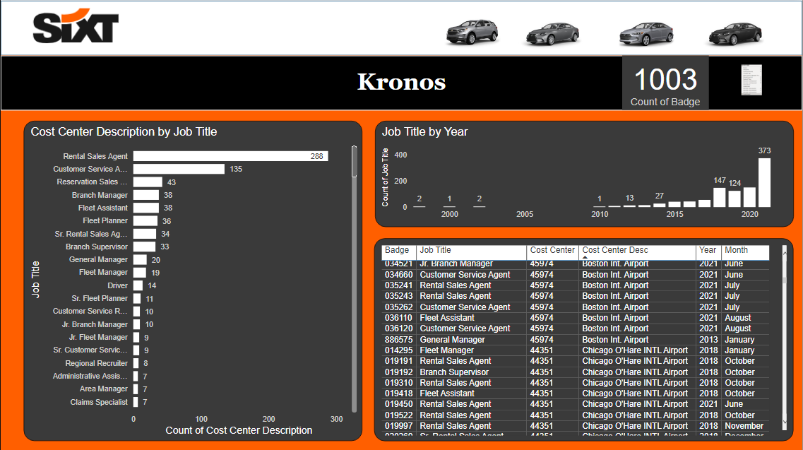
Retail sales Agents seem to be the largest position hires. Will need to investigate further regarding turn over.
Positive growth since 1998 by year and job titles. Showing a 373 hires in 2021 Vs 2 hires in 1998.
June, July and August show larges hires overall. Possibly due to seasonal vacations.
Last table is to showcase the information by badge, job title, cost center, description and date of hire.

Slide 4
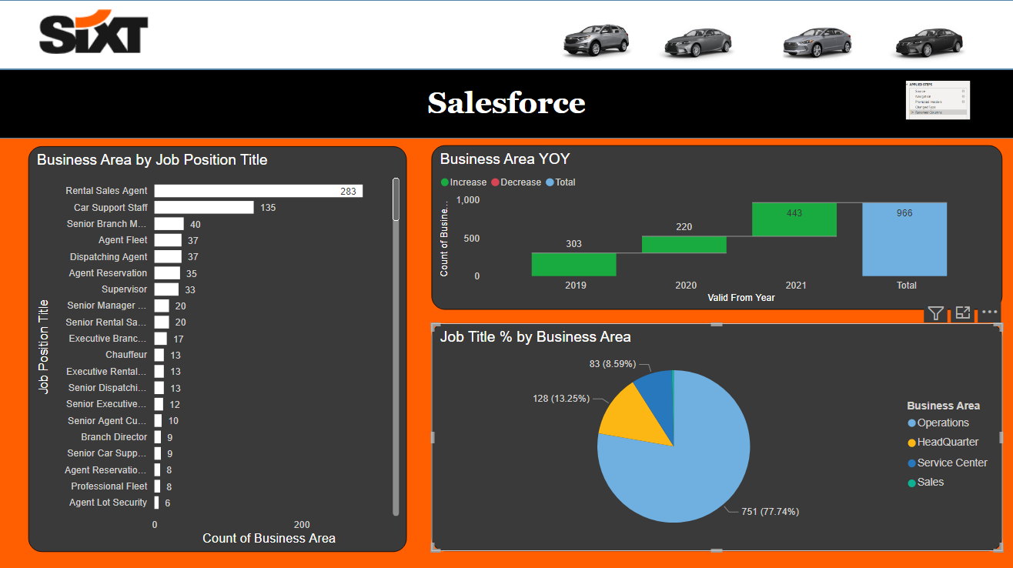
Retail sales Agents seem to be the largest position hires, followed by car support staff. Will need to investigate further regarding turn over.
Positive growth YOY since 2019 (31.7%) Vs 2021(45.86%). Hires increased 14% from 2019 Vs 2021.
Last table is to showcase the job titles percentage by business area.

Slide 5
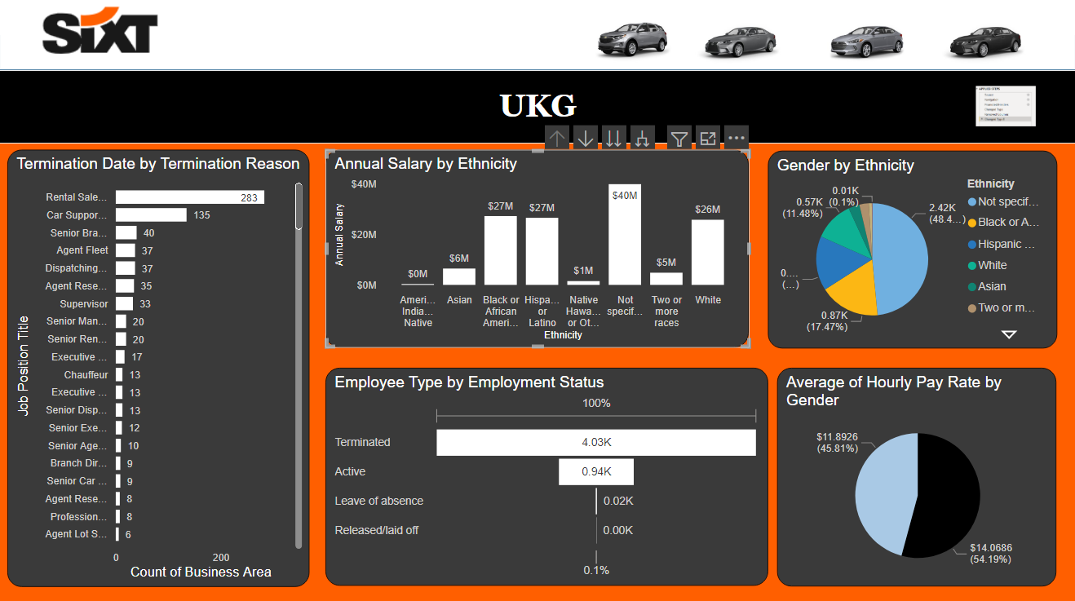
Retail sales Agents seem to be the largest position hires. Will need to investigate further regarding turn over. There seem to be a discrepancy between car support agent and car support staff (Maybe the same?)
Largest salary in 2018 observed with $31M. Not specified Ethnicity has the largest salary with $40M compared with Hispanics $27M and Whites with $26M.
Not specified seems to be the largest Ethnicity group with 48.4%. Will need to investigate why. Followed by African(17.4%) and Hispanics (15.69%).
Average per hour salary seems to be higher among men($14.06) Vs women ($11.89).
Seems to a be a substantial quantity of terminated employees, compared to active. Will need to observe the dates of termination. Is there a turnover issue? Could there be seasonal employment? Turnover issue? Will need further investigation.

Slide 6
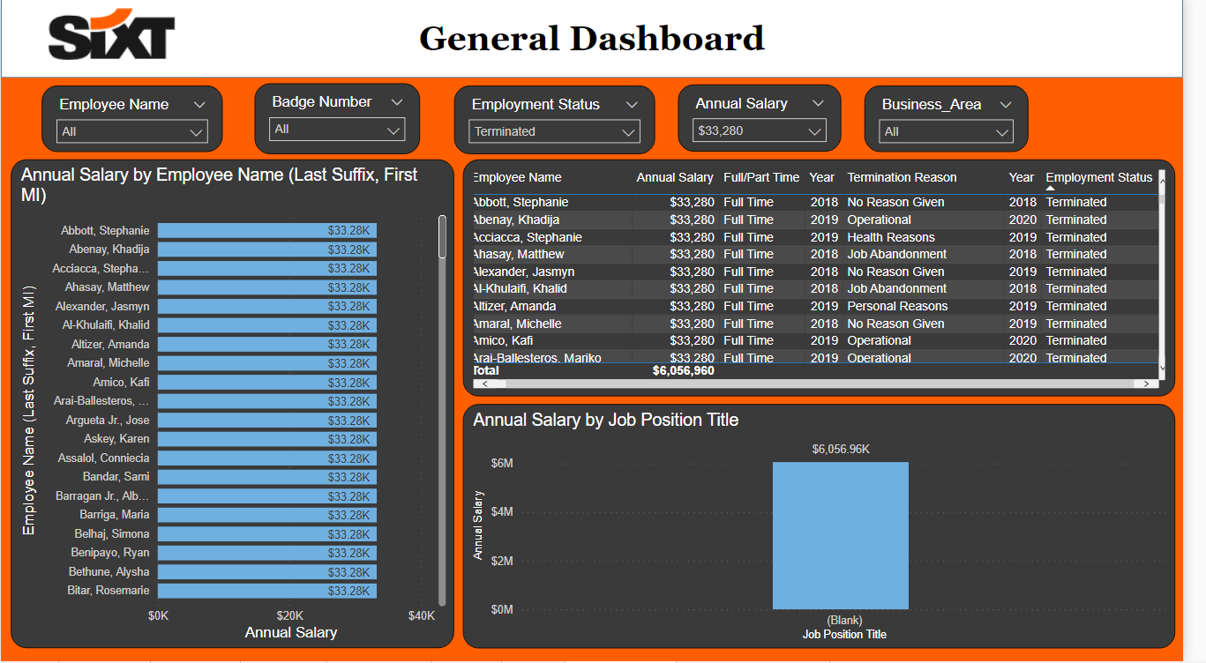
This is a dynamic dashboard demonstration where the stakeholder can filter depending on the criteria needed.
The example shown are “terminate” employees with a salary of “$33,280”.

Slide 7
